Slide 1
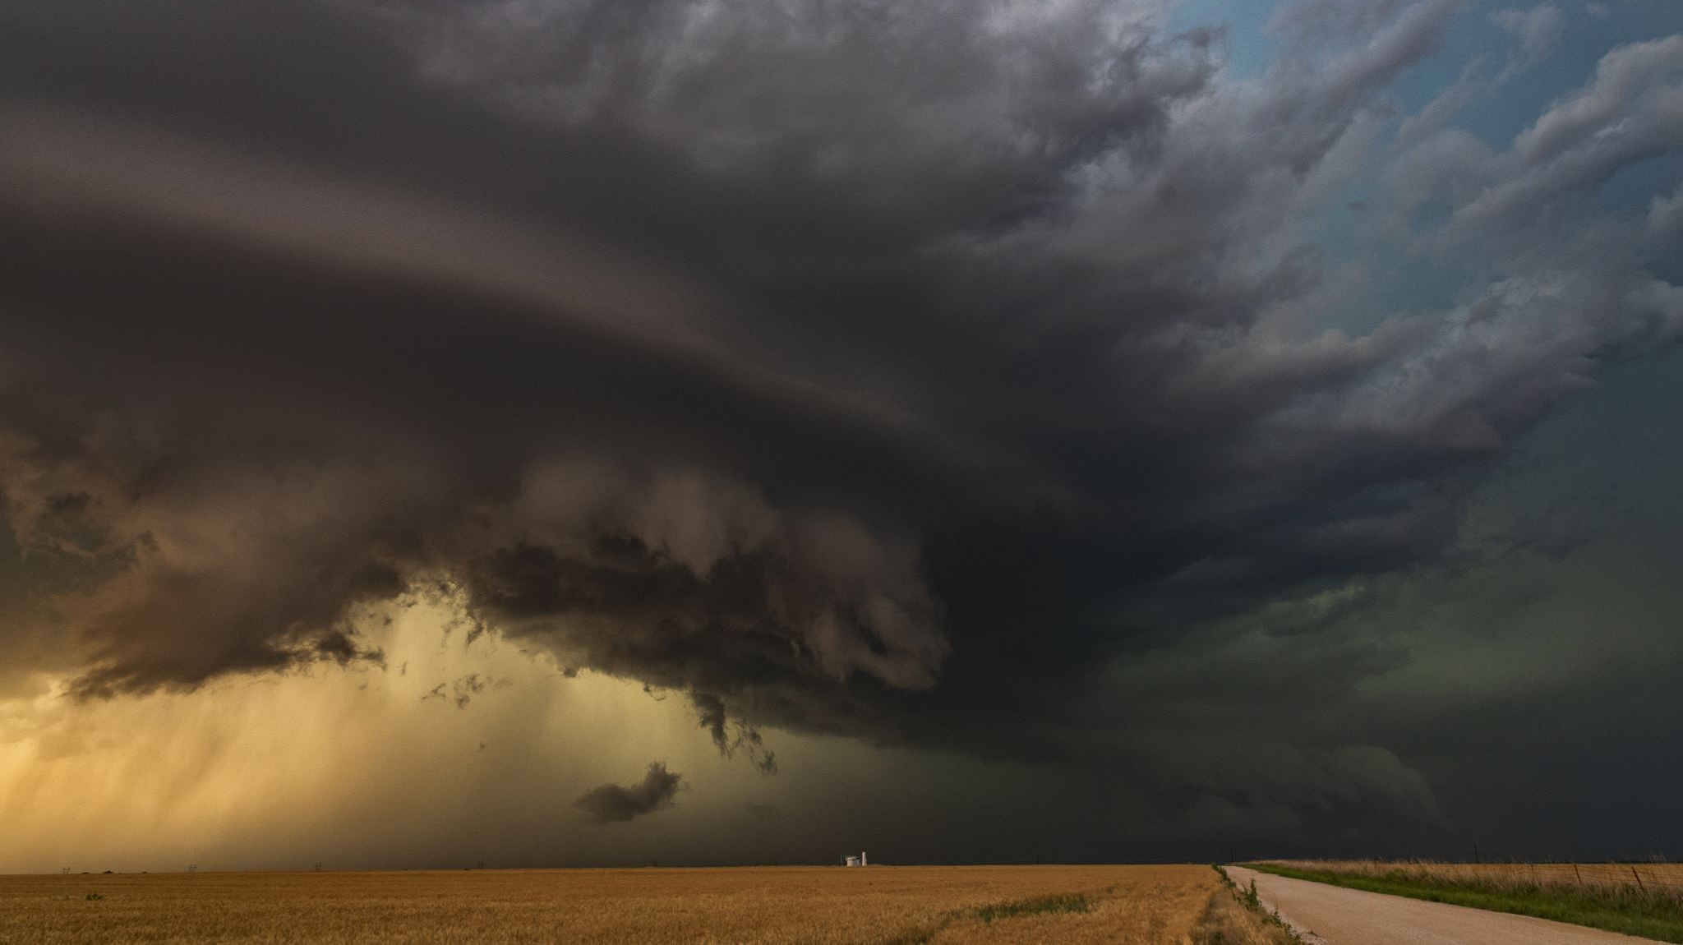
Rain in Australia
Predicting if it will rain tomorrow

Slide 2

Project Overview
This presentation details the process of predicting whether it will rain tomorrow in Australia using a machine learning model.

Slide 3

About Data
Our data is collected from the 26 cities of Australia over the period of 11 years which starts from 2007 to 2017.
Our data contain 23 Column

Slide 4
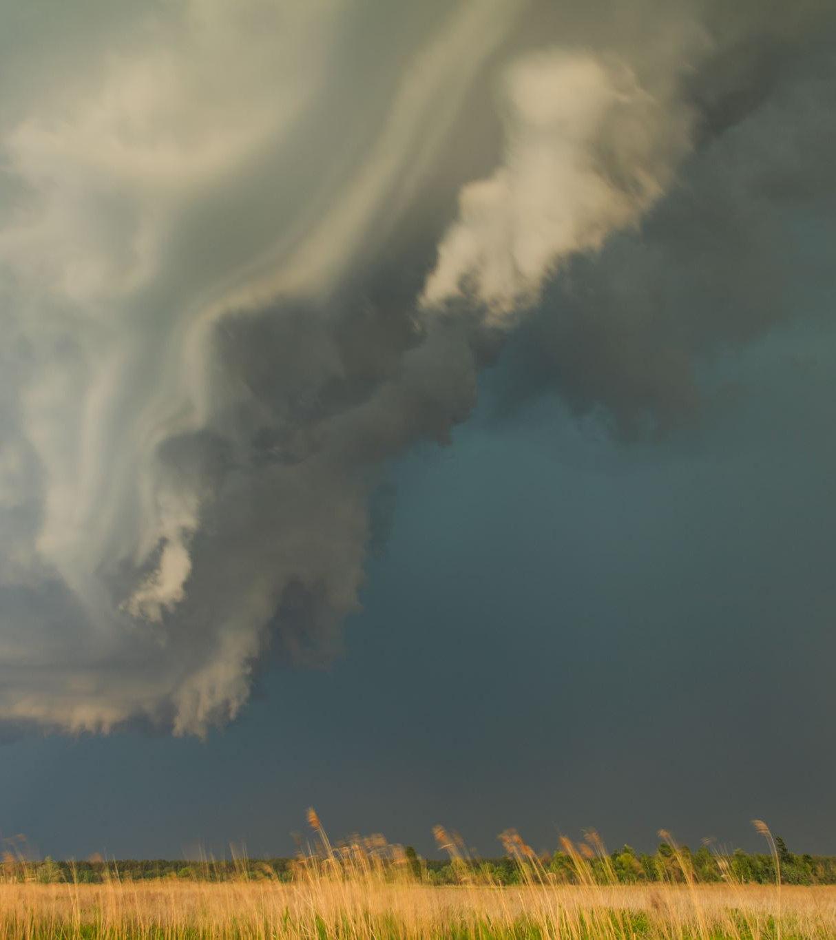
Problem Statement
The main aim of this project is to predict whether it will rain or not in Australia. Rain prediction depends upon several factors like temperature, humidity, wind speed, wind direction etc.

Slide 5
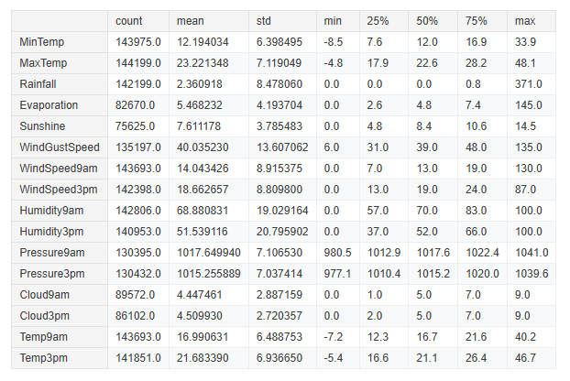
Data Discerption

Slide 6
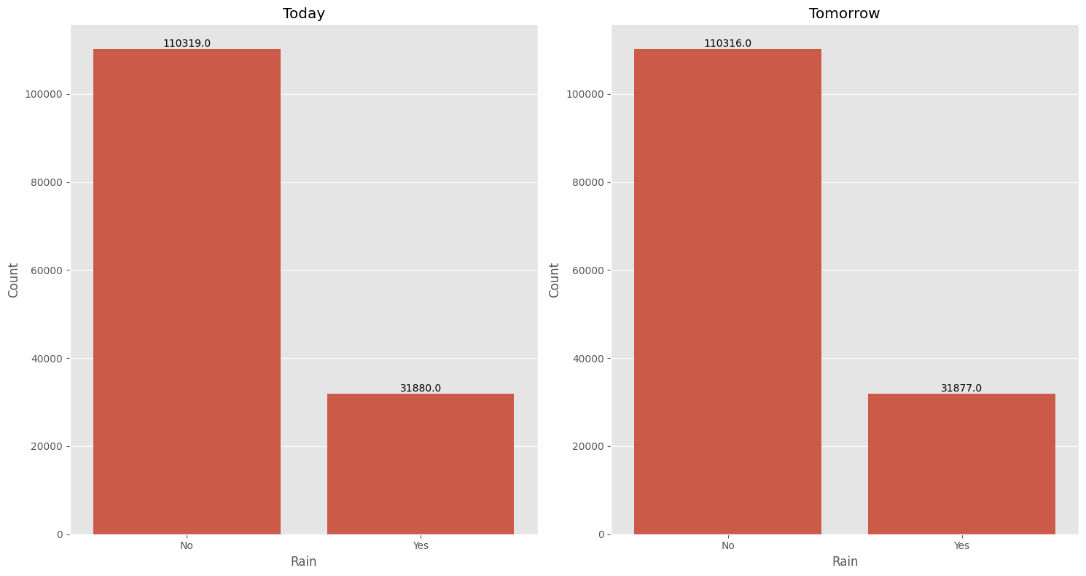
Rainfall

Slide 7
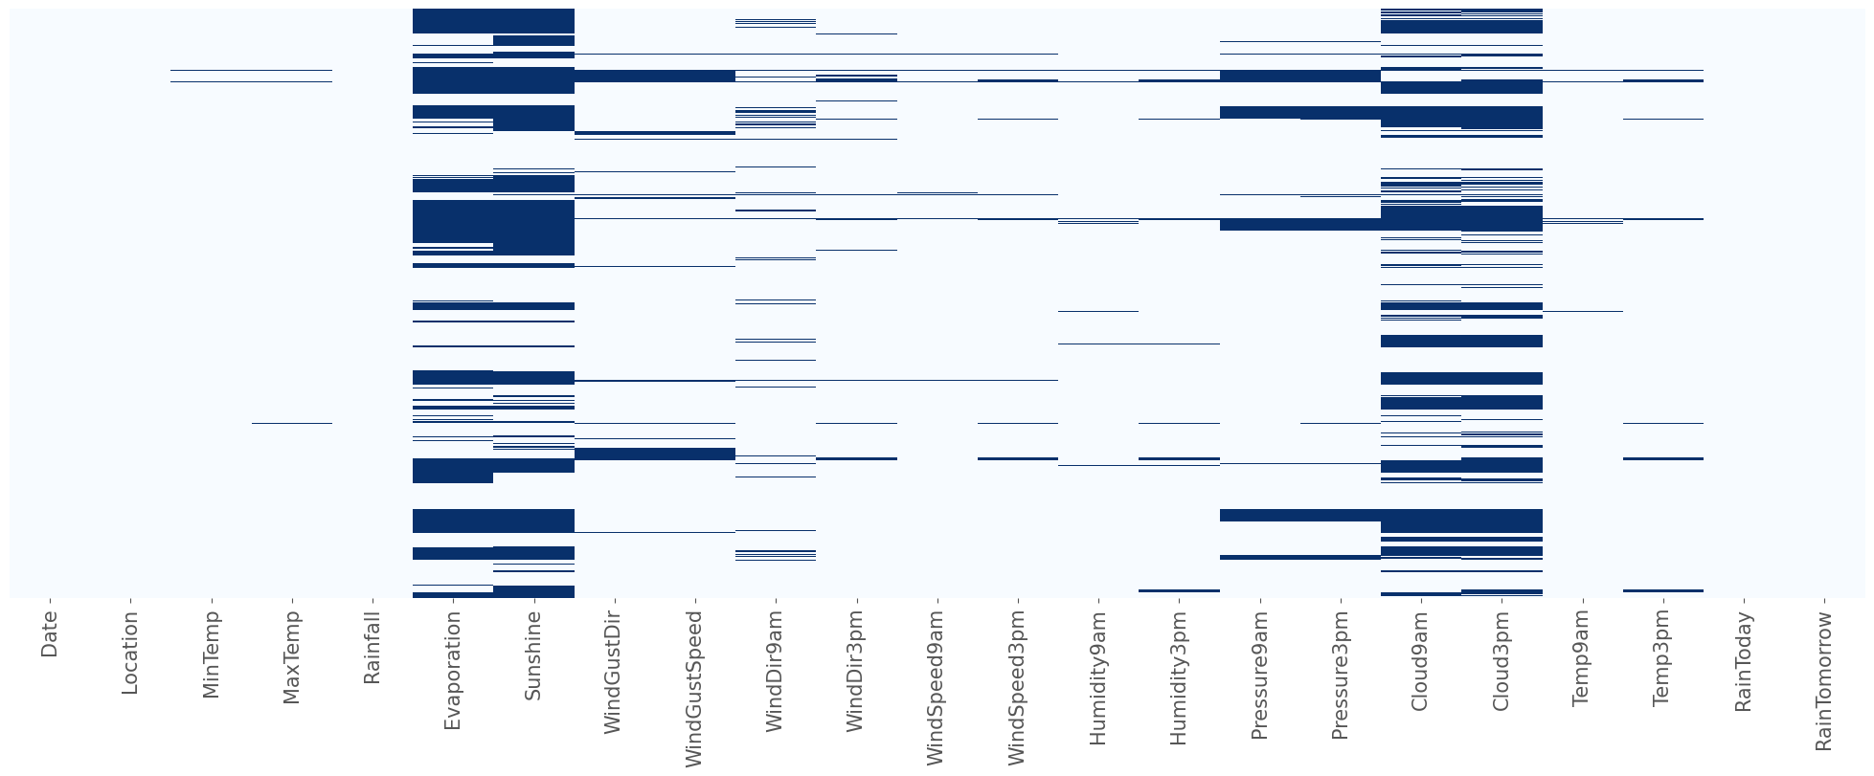
Missing Values

Slide 8
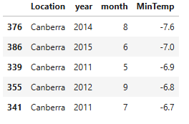
Observation: Min Temperature
According to the test statistics :
The range of MinTemp lies between -7.6 to 31.9
Canberra is the coldest city in Australia with MinTemp of -7.6

Slide 9
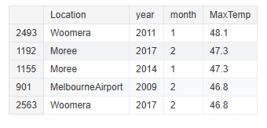
Observation: Max Temperature
According to the test statistics:
the range of MaxTemp lies in between 4.1 to 48.1
Woomera is the hottest city in Australia with the MaxTemp of 48.1 in 2011

Slide 10
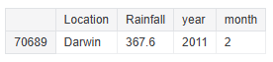
Observation: Rainfall
Darwin experience is highest amount of Rainfall in 2nd month of 2011 which recorded as 367.6 mm

Slide 11
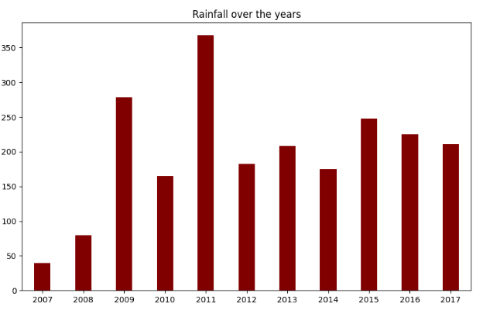
Observation: Rainfall
Data shows highest Rainfall occurred in 2011 followed by 2009 and 2015

Slide 12
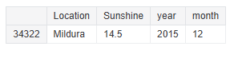
Observation: Sunshine
The maximum hours of Sunshine observed is 14.5 hours in Mildura city in 2015 in the month of December
The average hours of sunshine observed is 7.87 with 50% areas have experience more than 8 hours of sunshine
Womera , Perth and Hobart has experienced no sunshine in 2017 , 2012 and 2014 respectively for the months of June, May and February

Slide 13
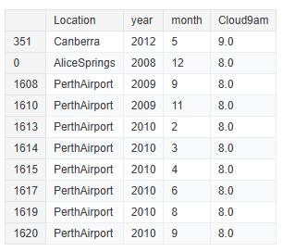
Observation: Cloud9am
0 means no cloud whereas 9 means overcast
The average cloud9am observed is 4.34 with 50% areas have experience 5 oktas
Canberra is the only location with the cloud9am oktas of 9 in the whole year in the month of May in our dataset

Slide 14
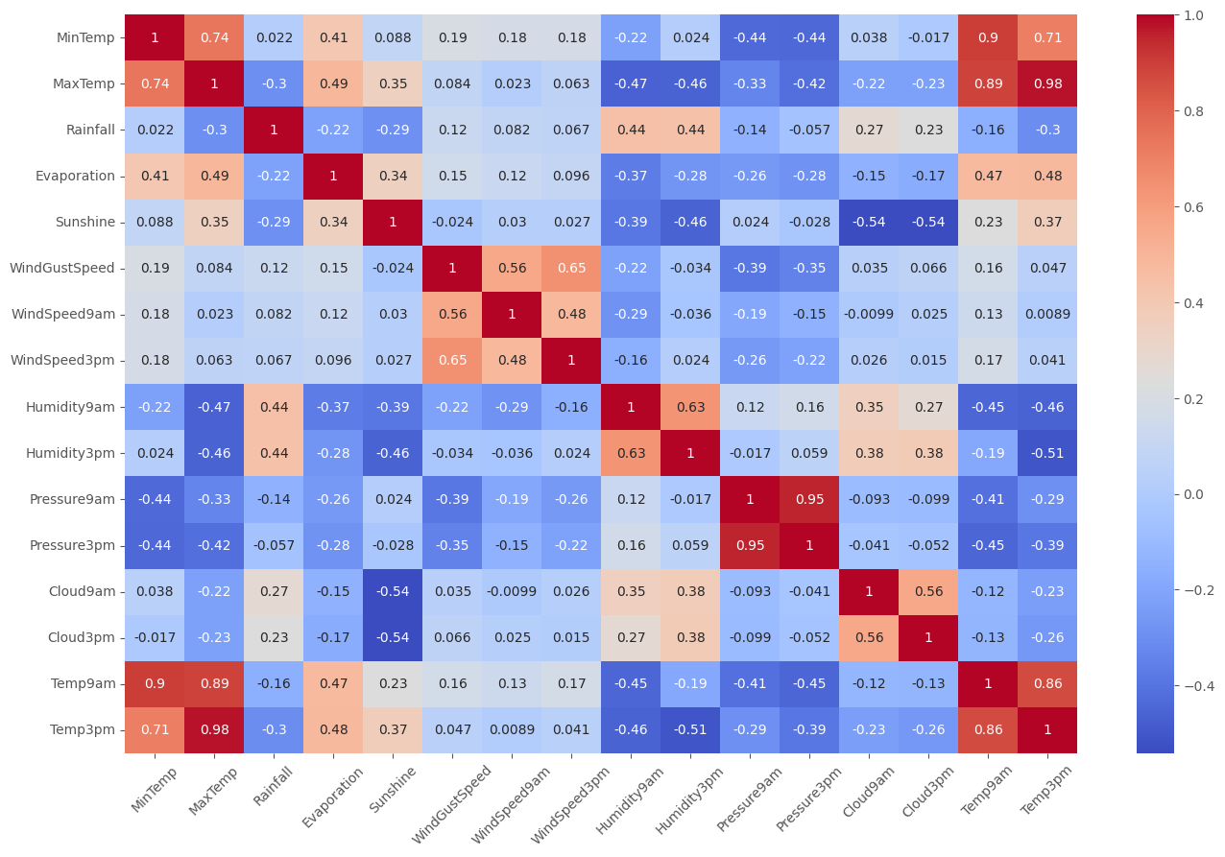
Data correlation

Slide 15
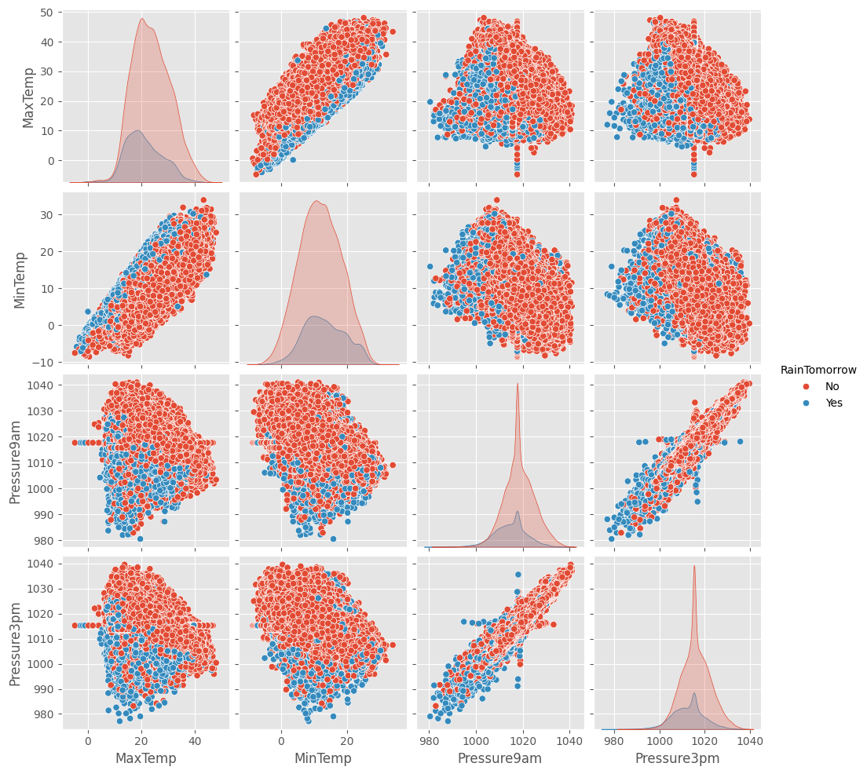

Slide 16
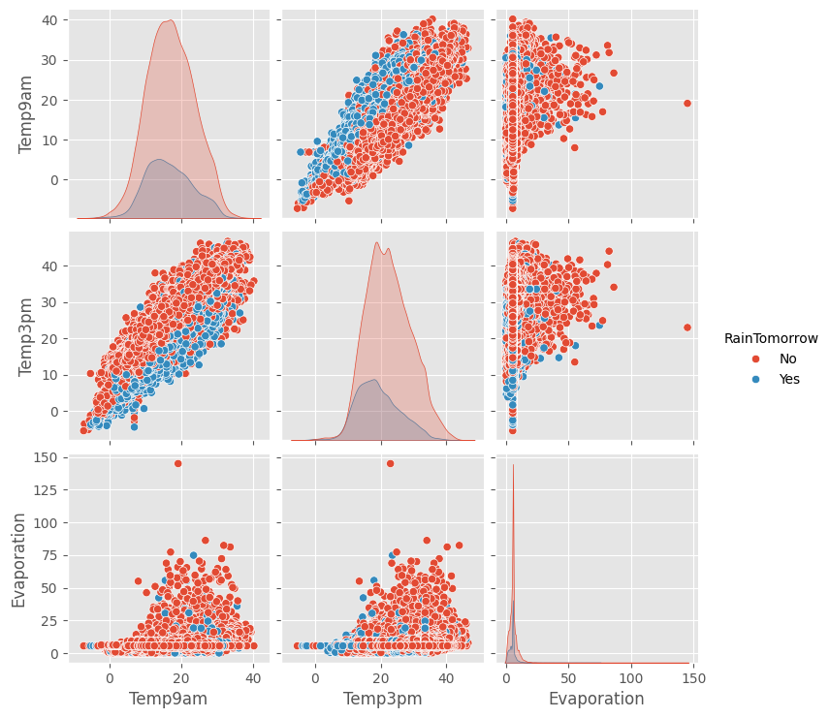

Slide 17
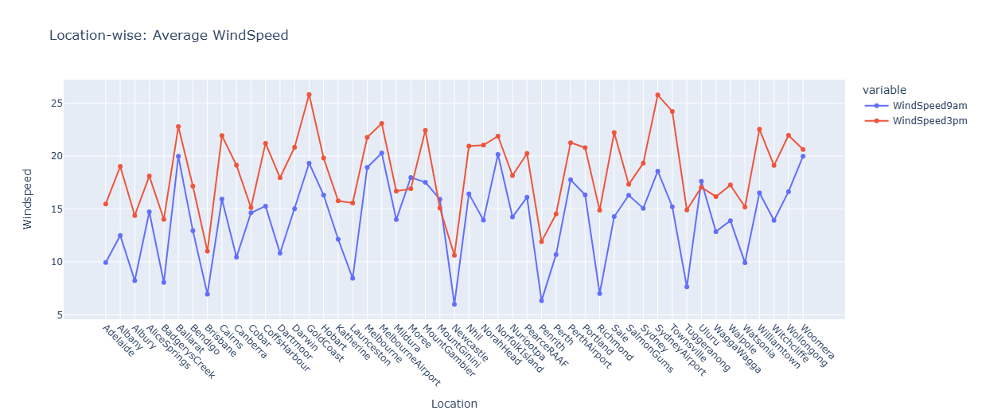

Slide 18
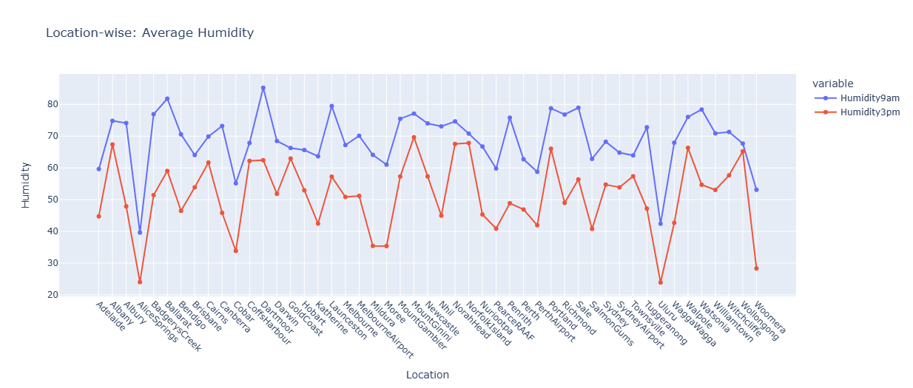

Slide 19
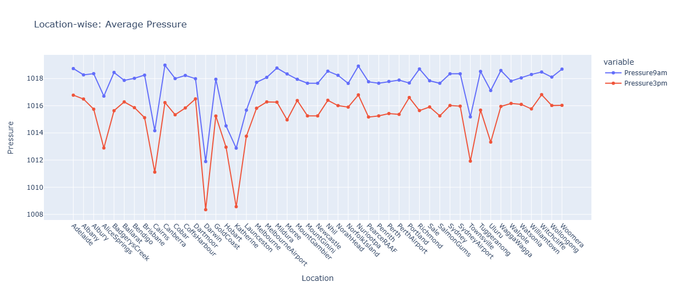

Slide 20
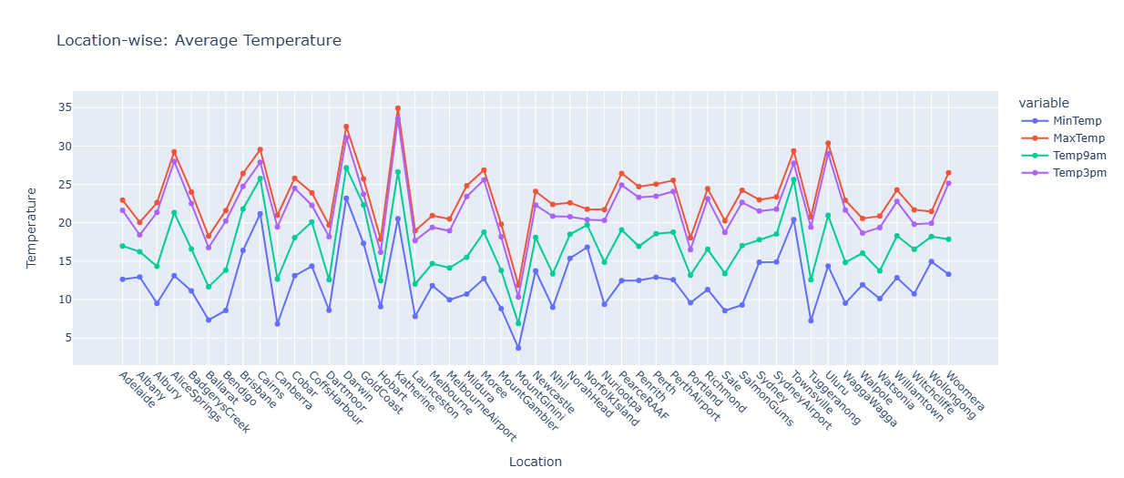

Slide 21
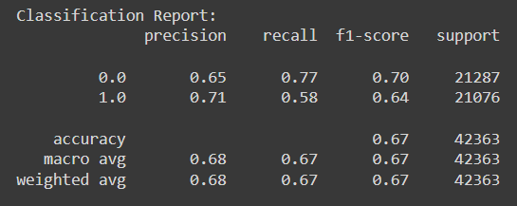
Logistic Regression
The precision score is 0.68 which indicates that our model can correctly identify 68% of the positive samples in the test set and we have very low count of false positives.
The recall score is 0.67 which indicates that our model can correctly identify 67% of the positive samples in the test set and we have very low count of false negatives.
The F1 score is the harmonic mean of precision and recall , score is 0.70
Accuracy is 67%

Slide 22
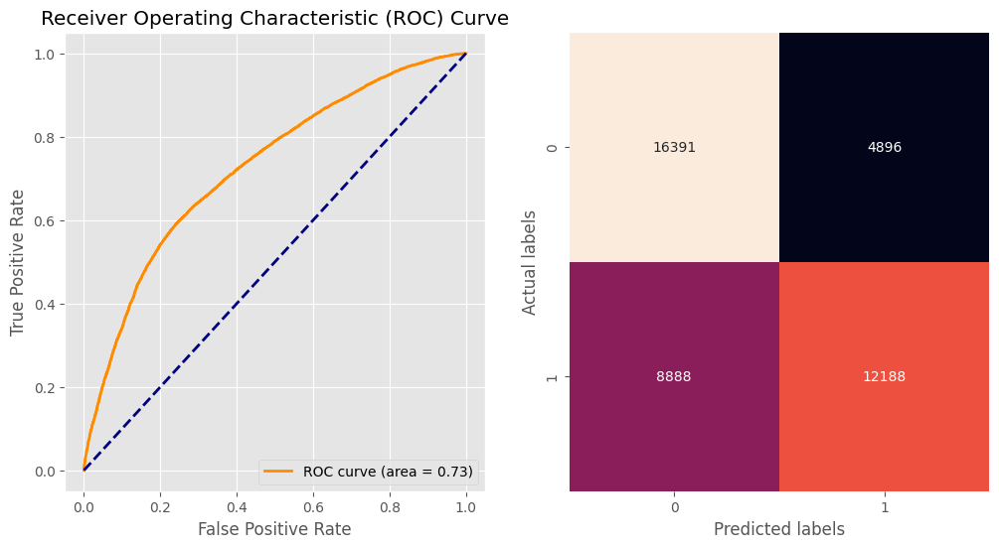

Slide 23
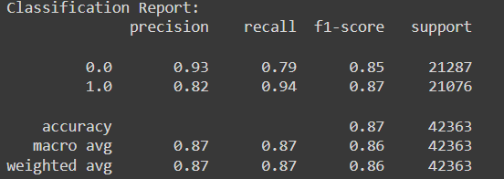
Decision Tree
The precision score is 0.87 which indicates that our model can correctly identify 87% of the positive samples in the test set and we have very low count of false positives.
The recall score is 0.87 which indicates that our model can correctly identify 87% of the positive samples in the test set and we have very low count of false negatives.
The F1 score is the harmonic mean of precision and recall , score is 0.86
Accuracy is 87%

Slide 24
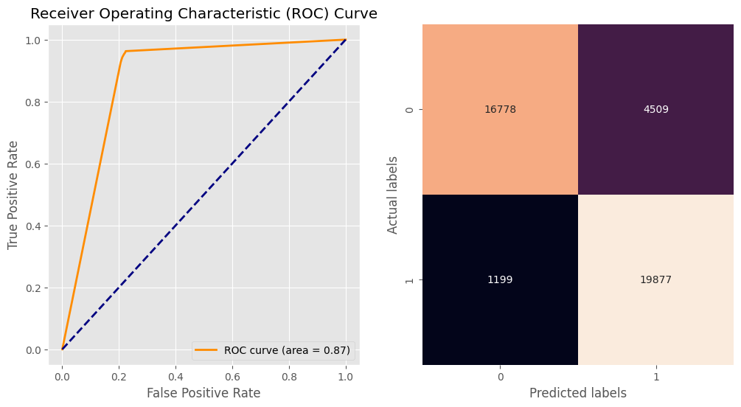

Slide 25
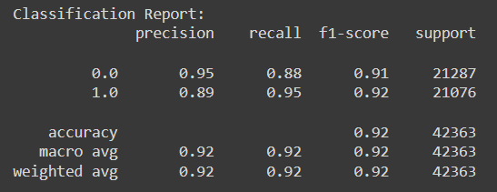
Random Forest
The precision score is 0.92 which indicates that our model can correctly identify 92% of the positive samples in the test set and we have very low count of false positives.
The recall score is 0.92 which indicates that our model can correctly identify 92% of the positive samples in the test set and we have very low count of false negatives.
The F1 score is the harmonic mean of precision and recall , score is 0.92
Accuracy is 92%

Slide 26
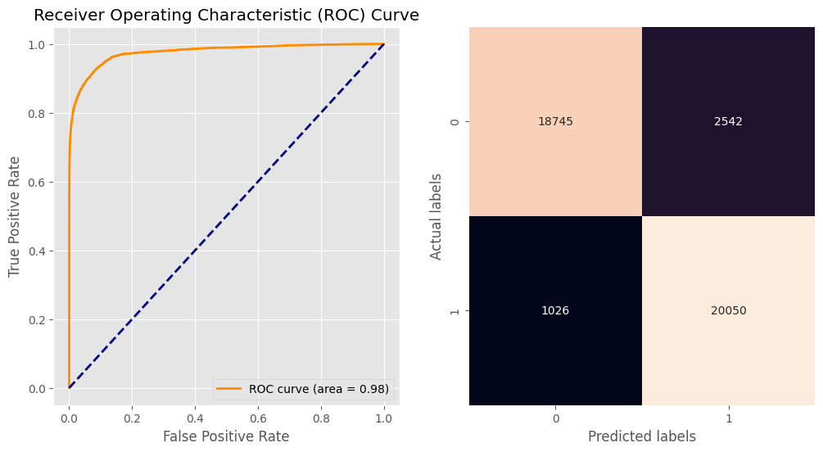

Slide 27
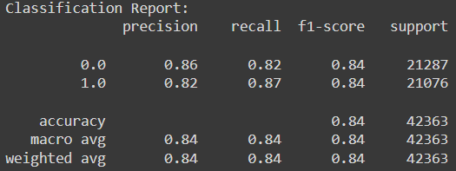
XGBoost
The precision score is 0.84 which indicates that our model can correctly identify 84% of the positive samples in the test set and we have very low count of false positives.
The recall score is 0.84 which indicates that our model can correctly identify 84% of the positive samples in the test set and we have very low count of false negatives.
The F1 score is the harmonic mean of precision and recall , score is 0.84
Accuracy is 84%

Slide 28


Slide 29
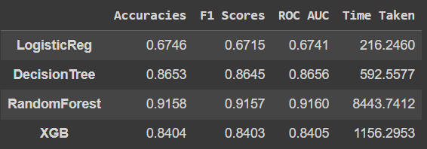
Model Comparison

Slide 30
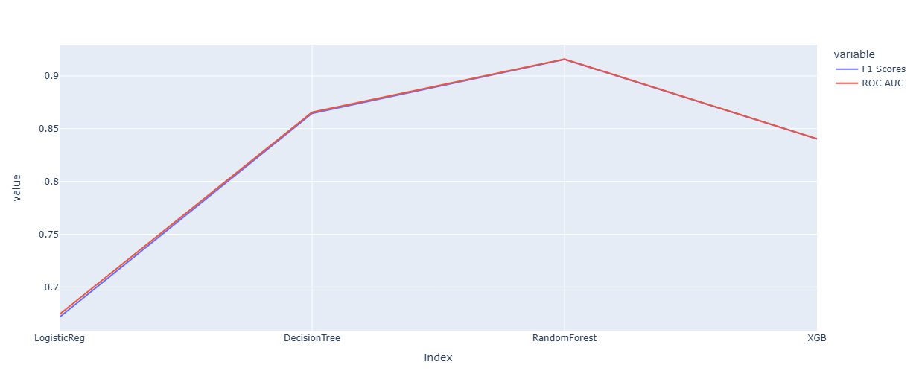

Slide 31
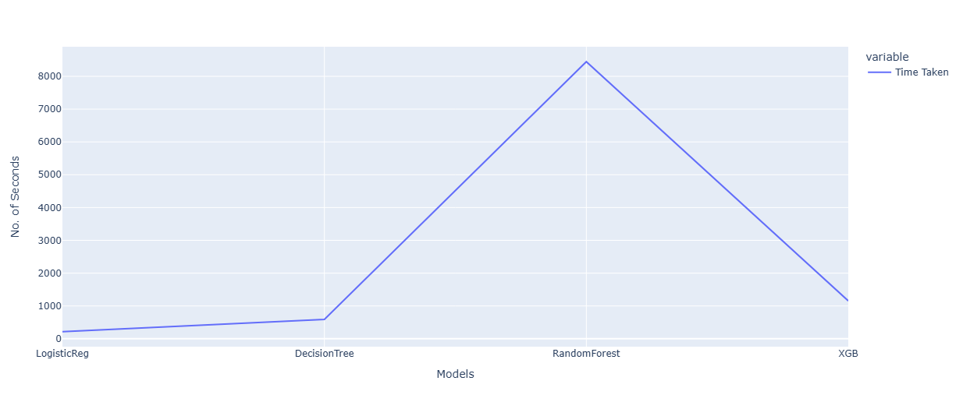

Slide 32
Thank you

Slide 34


